Slide 1
Success Factors in relation with SMEs performance

Slide 2
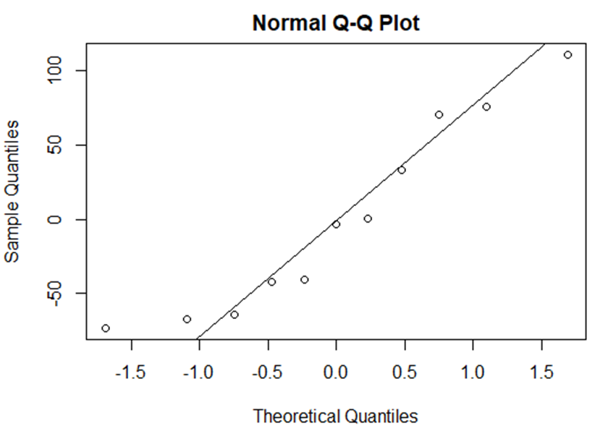
Chart
The points are too close to the line which indicates that there is a linear relationship.
The points distribute around the line which indicates that there is a strong relationship between the variables.
and as it shown on the graph, its positive relation

Slide 3
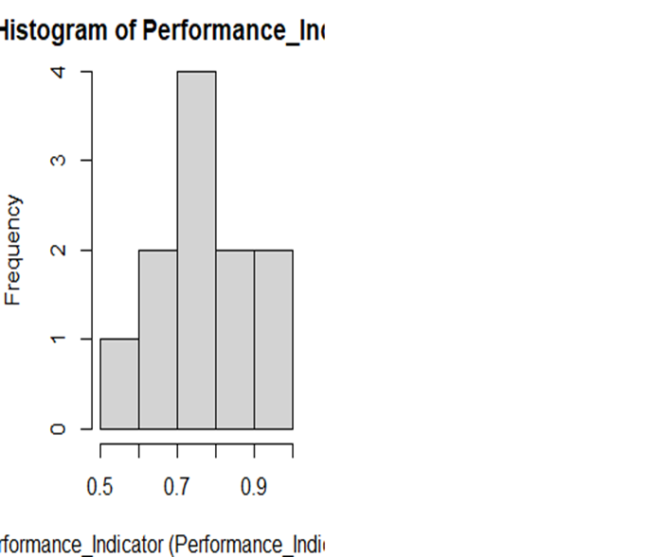
Histogram
Histogram is symmetric. So it confirms the normal distribution. ‐ Mean=Median=Mode

Slide 4
Correlations:-
Coefficients:
Estimate Std. Error t value Pr(>|t|)
(Intercept) -232.3 145.3 -1.598 0.1486
Government Effectiveness 799.1 327.5 2.440 0.0406 *
Regulatory_Quality 676.3 394.2 1.716 0.1246
---
Signif. codes: 0 ‘***’ 0.001 ‘**’ 0.01 ‘*’ 0.05 ‘.’ 0.1 ‘ ’ 1
Residual standard error: 72.23 on 8 degrees of freedom
Multiple R-squared: 0.8899, Adjusted R-squared: 0.8623
F-statistic: 32.32 on 2 and 8 DF, p-value: 0.0001472
We will notice that, the model is Significant since its less than 5%, and the Person correlation is positive which means that there is a positive/strong relationship between the variables

Slide 5
R & R2
Coefficients:
Estimate Std. Error t value Pr(>|t|)
(Intercept) -232.3 145.3 -1.598 0.1486
Government_Effectivness 799.1 327.5 2.440 0.0406 *
Regulatory_Quality 676.3 394.2 1.716 0.1246
---
Signif. codes: 0 ‘***’ 0.001 ‘**’ 0.01 ‘*’ 0.05 ‘.’ 0.1 ‘ ’ 1
Residual standard error: 72.23 on 8 degrees of freedom
Multiple R-squared: 0.8899, Adjusted R-squared: 0.8623
F-statistic: 32.32 on 2 and 8 DF, p-value: 0.0001472
This table indicate the value of R and R square and even the Adjusted are square, and as its shown in the table, the value of R square indicates that there is a strong positive relationship between the success factors & the performance of SMEs

Slide 6
ANOVA Table
Coefficients:
Estimate Std. Error t value Pr(>|t|)
(Intercept) -232.3 145.3 -1.598 0.1486
Government_Effectivness 799.1 327.5 2.440 0.0406 *
Regulatory_Quality 676.3 394.2 1.716 0.1246
---
Signif. codes: 0 ‘***’ 0.001 ‘**’ 0.01 ‘*’ 0.05 ‘.’ 0.1 ‘ ’ 1
Residual standard error: 72.23 on 8 degrees of freedom
Multiple R-squared: 0.8899, Adjusted R-squared: 0.8623
F-statistic: 32.32 on 2 and 8 DF, p-value: 0.0001472
As its shown in this table, the model is Sig which indicates that it follows Normal Distribution. â€ , the model is Significant since its less than 5%. Therefore there is a significant relationship between the variables

Slide 7
Coefficients & Equation
‐ We could extract the predicated values from this table, it would be as following: -
B0=-450.532, B1 =70.695, B2=872.021, B3=712.559
‐ So the equation will be:-
Y^(SMEs performance)=-232.3+ (Government Effectiveness)^+799.1(Regulatory Quality)^+676.3
‐ This means that:-
once the Government Effectiveness increase by 1 unit, the SMEs performance will increase by 799.1
once the Regulatory Quality increase by 1 unit, the SMEs performance will increase by 676.3
Coefficients:
Estimate Std. Error t value Pr(>|t|)
(Intercept) -232.3 145.3 -1.598 0.1486
Government Effectiveness 799.1 327.5 2.440 0.0406 *
Regulatory_Quality 676.3 394.2 1.716 0.1246
---
Signif. codes: 0 ‘***’ 0.001 ‘**’ 0.01 ‘*’ 0.05 ‘.’ 0.1 ‘ ’ 1
Residual standard error: 72.23 on 8 degrees of freedom
Multiple R-squared: 0.8899, Adjusted R-squared: 0.8623
F-statistic: 32.32 on 2 and 8 DF, p-value: 0.0001472

Slide 8
Conclusion :-
We can end up with many important results, and we will try to sum them up in the below points:
There is a strong positive relationship between the variables, its sig relationship as the Independent variable (success factors) affects the Dependent variable (SMEs performance)
some economical, legal, cultural and educational problems. The research suggests the significance of developing SMEs skills and takes necessary actions based on promoting of entrepreneurial thought. Along with allowing small credits and developing suitable conditions to encourage entrepreneurship it should not be overestimated the importance of education cannot be overestimated. Absence of necessary SMEs skills and education in this field can minimize the efforts made by the government to develop entrepreneurship.

